Slide 1
Final Engagement
Attack of a Vulnerable Network

Slide 2
Table of Contents
This document contains the following resources:
Network Topology & Vulnerabilities
Exploits Used
Mitigations

Slide 3

Network Topology
& Vulnerabilities
3

Slide 4
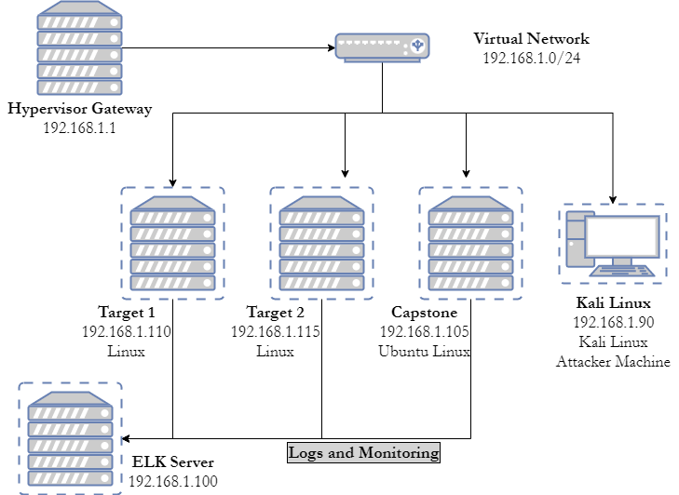
Network Topology
Network
Address Range: 192.168.1.0/24
Netmask: 255.255.255.0
Gateway: 192.168.1.1
Machines
IPv4: 192.168.1.90
OS: Debian Kali 5.4.0
Hostname: Kali
IPv4: 192.168.1.100
OS: Ubuntu Linux 18.04
Hostname: ELK IPv4: 192.168.1.105
OS: Ubuntu Linux 18.04
Hostname: Capstone
IPv4: 192.168.1.110
OS: Debian GNU/Linux 8
Hostname: Target 1

Slide 5
Critical Vulnerabilities: Target 1
Our assessment uncovered the following critical vulnerabilities in Target 1.
Vulnerability | Description | Impact
Common web dir naming. | Having the wordpress software in a folder rather than the http root/vhost. | Allows wordpress to be more easily identified as the framework in use.
Incorrect dir permissions. | Enabling a user other than the owner/webserver to access dirs. | Allows users to view or modify files/folders containing sensitive information
SUID bit set for python. | Allows users to run python and therefore code as root | Privilege escalation to root.
Root database user. | Using the root user access for a web app rather than a specific credentials. | Malicious user/application access to entire database.

Slide 6
Exploits Used
6

Slide 7
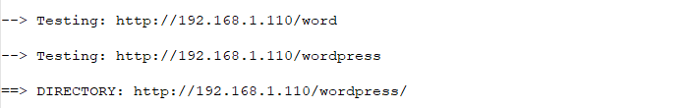
Exploitation: Common web dir naming
Tool: dirb
Outcome: Located the /wordpress/ directory on the target, identifying the web framework in use.

Slide 8
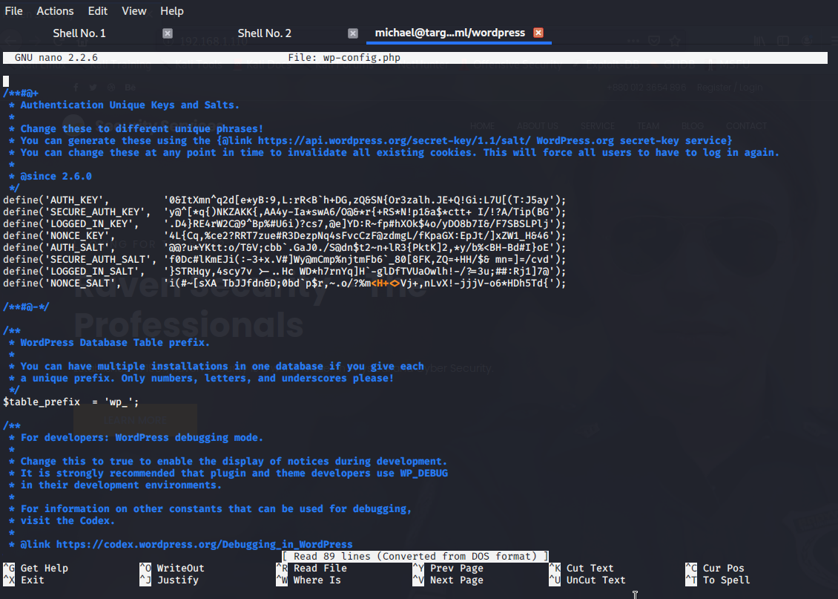
Exploitation: Incorrect dir permissions
Tool: ls -la
Outcome: The wordpress directory permissions were incorrectly set allowing all users to read the configuration file for the wordpress installation which contains sensitive information including database credentials in plantext .

Slide 9
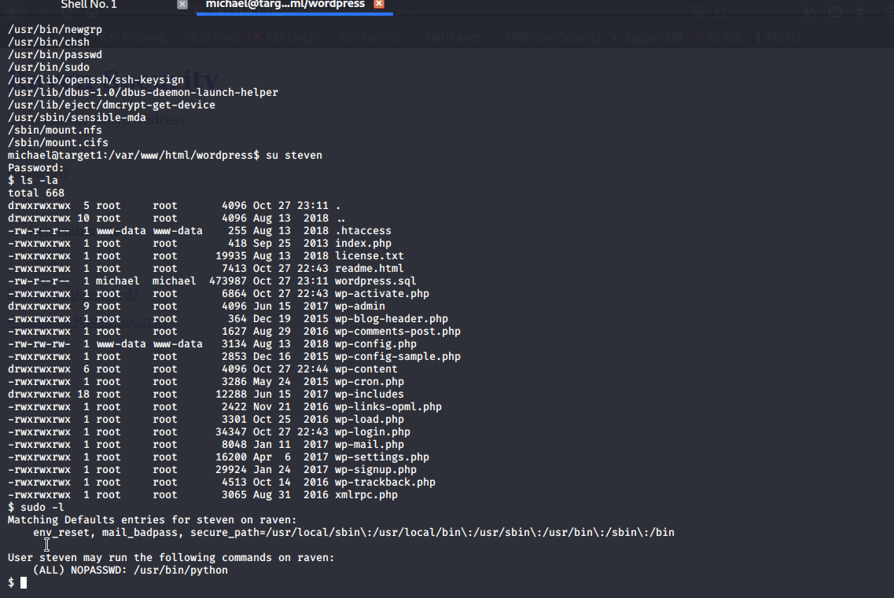
Exploitation: SUID bit set for python
Summarize the following:
Tool: sudo -l
Outcome: Displays applications the user is able to run under sudo privileges, in this case python

Slide 10
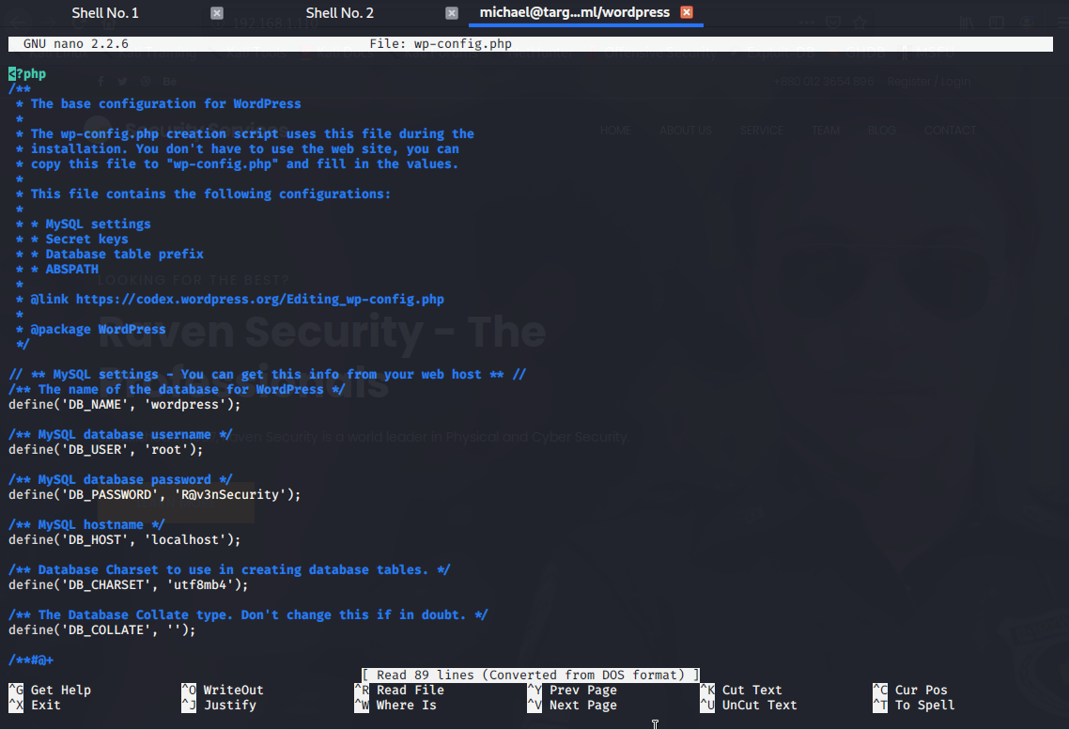
Exploitation: Root database user
Tool: mysql
Outcome: By exposing the root user credentials, we were able to dump all the records from the database including user credentials for other areas.

Slide 11
Exploitation Mitigations
11

Slide 12
Exploitation of Common web directory naming
Mitigation
Set monitoring alerts for above normal numbers 404 errors.
Set monitoring alerts for above normal file requests/minute.
Consider a virtual host or installing to the web root.

Slide 13
Exploitation of Incorrect directory permissions
Mitigation
Utilise the least permissions practice.
Create a user or group for specific access.
If possible, do not store plain text credentials. Nb in the case of wordpress and many PHP webapps this is just not possible.

Slide 14
Exploitation of SUID bit set for python
Mitigation
Utilise the least permissions practice.
Harden filesystem access preventing SUID use.

Slide 15
Exploitation of Root database user
Mitigation
Ensure use of a highly secure root password.
Give each webapp it’s own database credentials and grant access only to it’s individual database or tables.
If possible do not store credentials in plain text.

